Slide 1
NUMTS
Chr:3
Chr:2
Chr:1
Marius Botos
22.03.2023

Slide 2
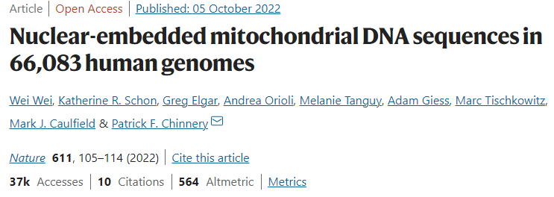
Workflow

Slide 3
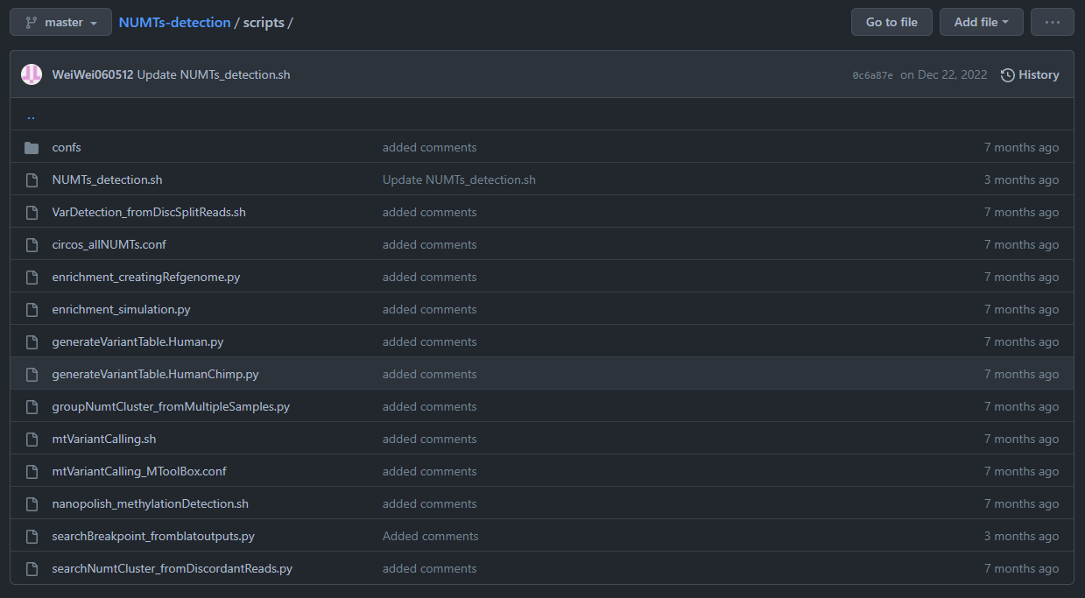
Workflow

Slide 4
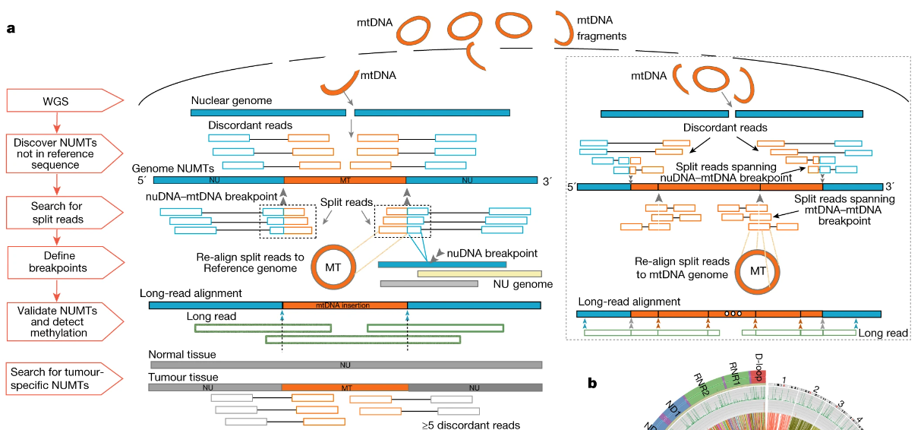
Numts selection

Slide 5
Samblaster and Samtools → Discordant reads (nuDNA read / mtDNA read)
Cluster → Maxgap = 500bp
Minimum of two reads per cluster >2 reads (maintained paper)
Filter results for nDNA/mtDNA read > 20bp (changed paper, 5bp)
mtDNA NCBI sequence overlap using Granges (NC_035159.1)
Visualization

Slide 6
Methods paragraph
To detect NUMTs, we used the aligned WGS BAM files and and extracted the discordant read pairs using samblaster and samtools and included the read pairs where one end aligns to nuclear genome and the other end aligns to the mtDNA reference sequence. The reads with mapping quality higher than 0 were used. The discordant reads were then clustered together based on sharing the same orientation and whether they were within a distance of 500 bp. We detected the clusters supported by at least two pairs of discordant reads. The NUMTs within a distance of 500bp on both nuclear DNA and mtDNA were grouped as the same NUMT. We found the NUMTs supported by at least two pairs of discordant reads.

Slide 7
Methods paragraph Luiz
To detect NUMTs, we used the aligned WGS BAM files and extracted the discordant read pairs using samblaster and included the read pairs where one end aligns to nuclear genome and the other end aligns to the mtDNA reference sequence. The reads with mapping quality equal to zero were discarded. The discordant reads were then clustered together based on sharing the same orientation and whether they were within a distance of 500 bp. We detected the clusters supported by at least two pairs of discordant reads, and filtered out the clusters supported by less than five pairs of discordant reads in our main analysis. The NUMTs within a distance of 1,000 bp on both nuclear DNA and mtDNA were grouped as the same NUMT. We generated two sets of NUMTs based on the NUMTs supported by at least two pairs of discordant reads and at least five pairs of discordant reads.

Slide 8
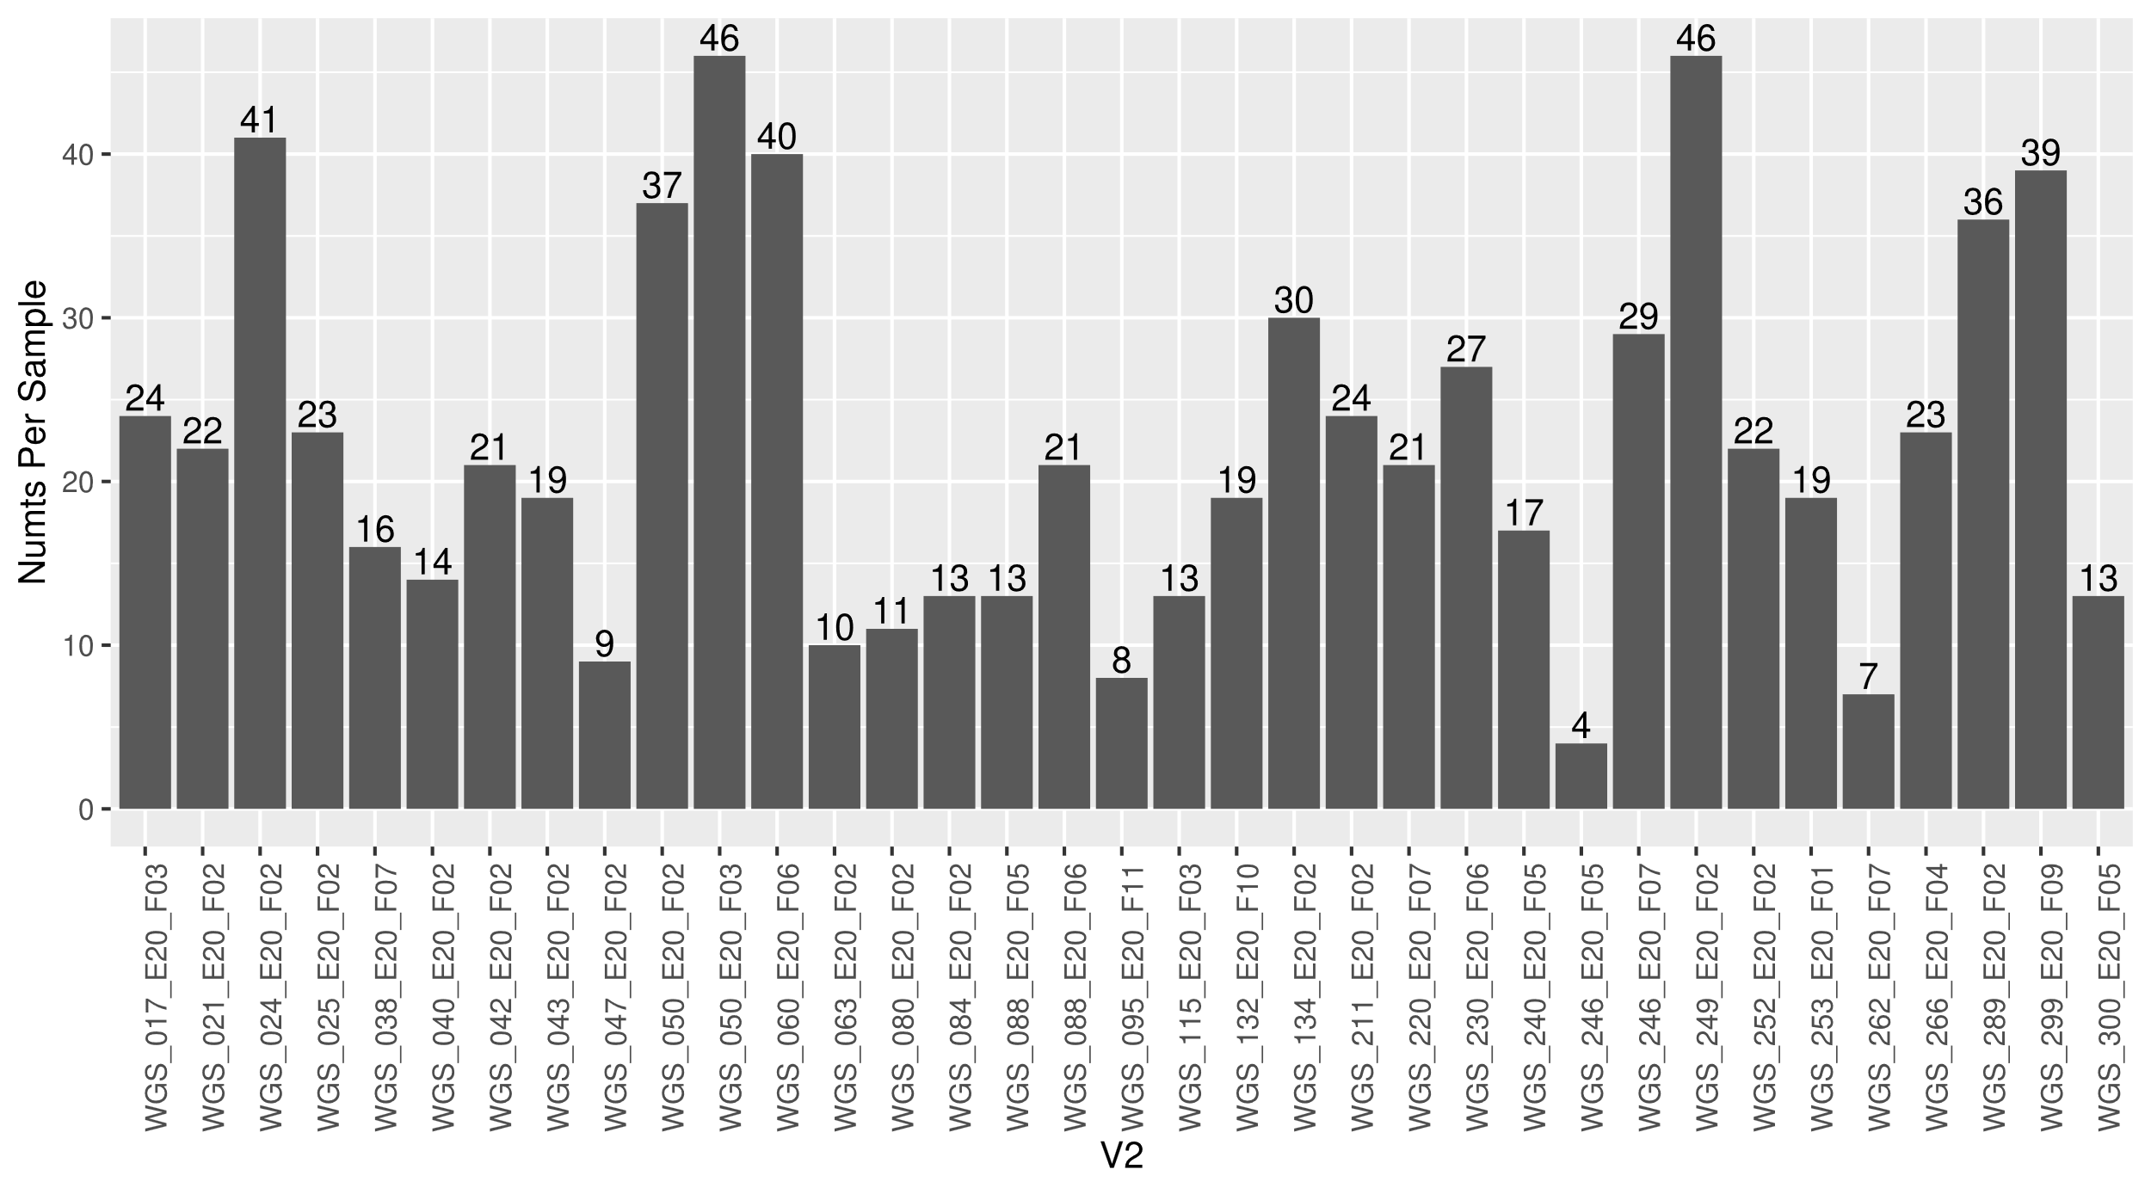
Overall NUMTs Chr(1,2,3)

Slide 9
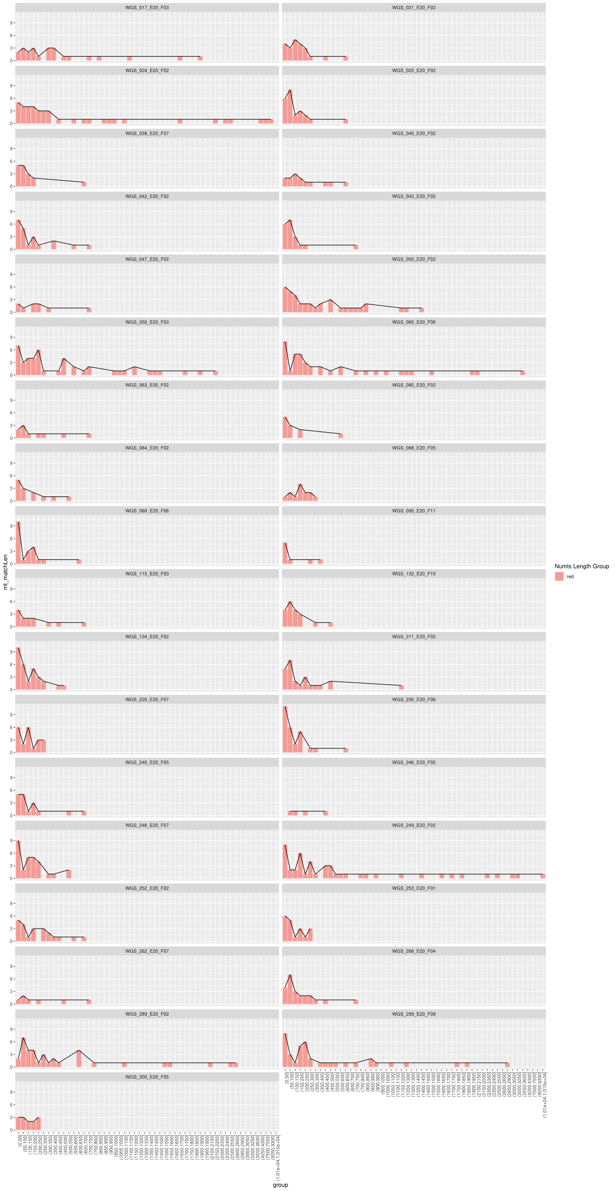
Size distribution of NUMTs

Slide 10
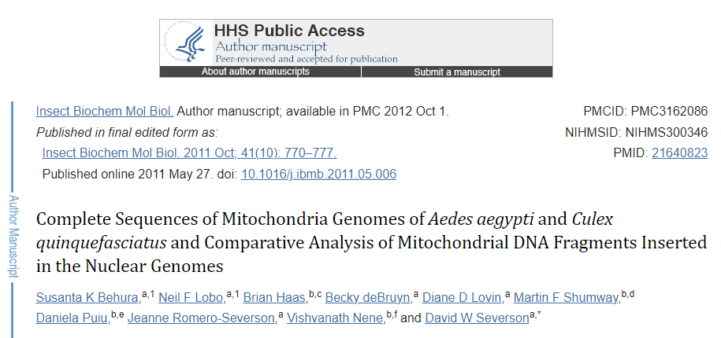
Known NUMTs

Slide 11
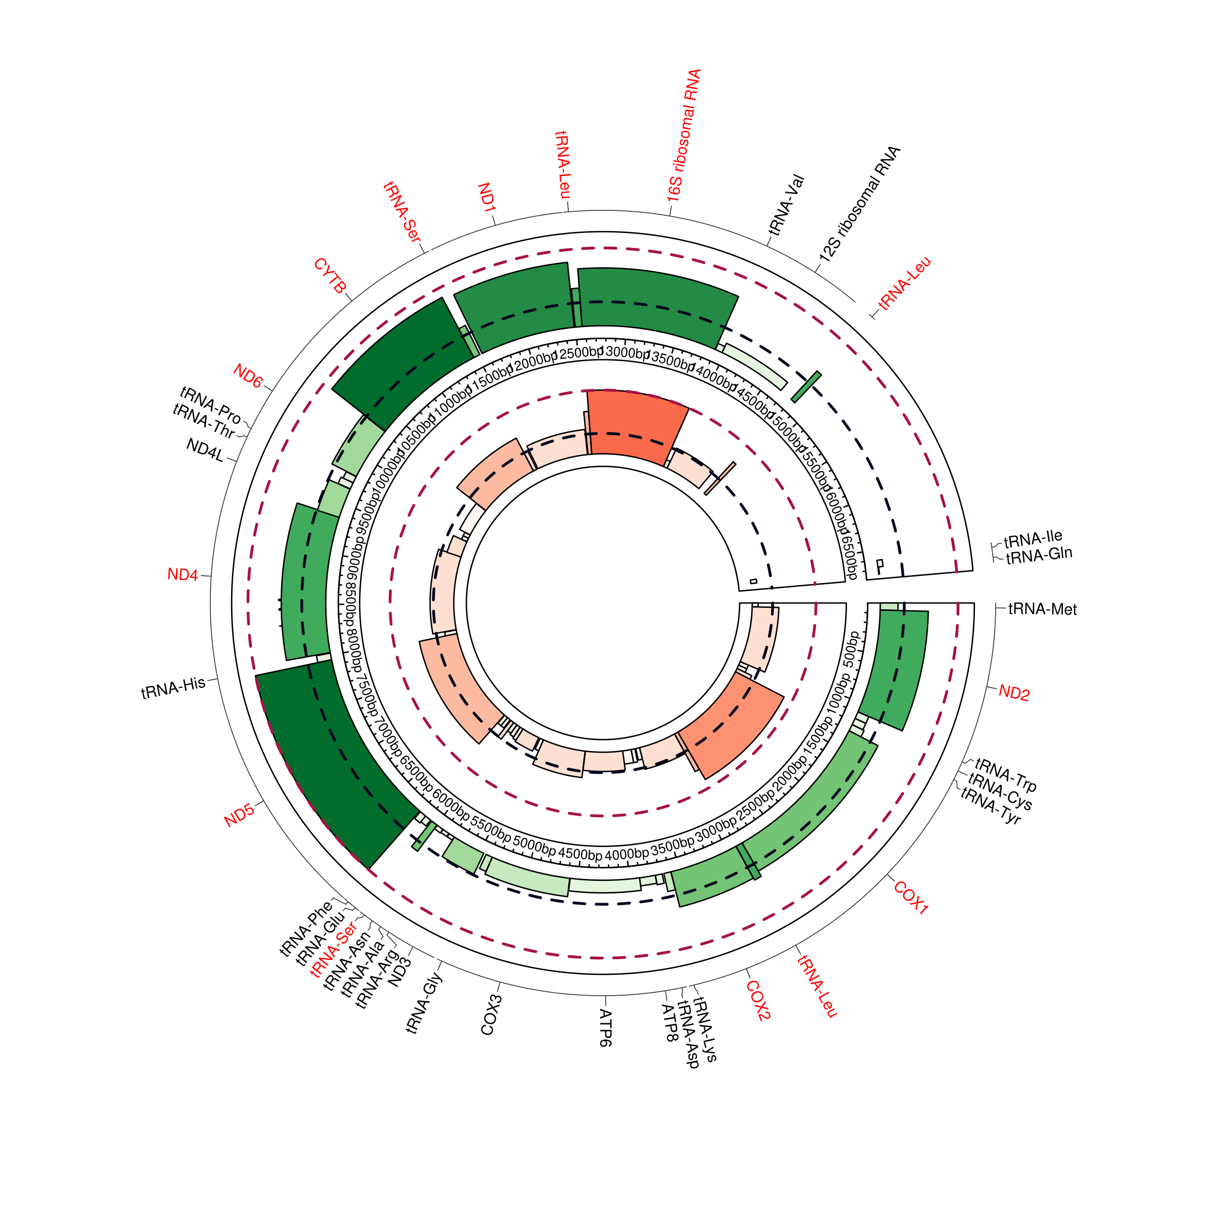
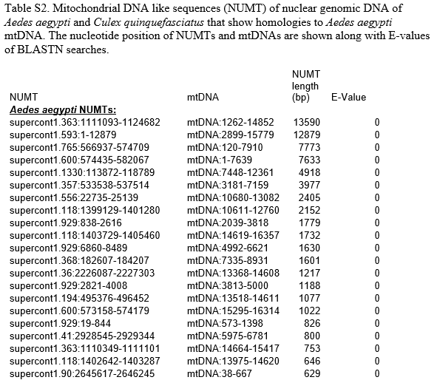
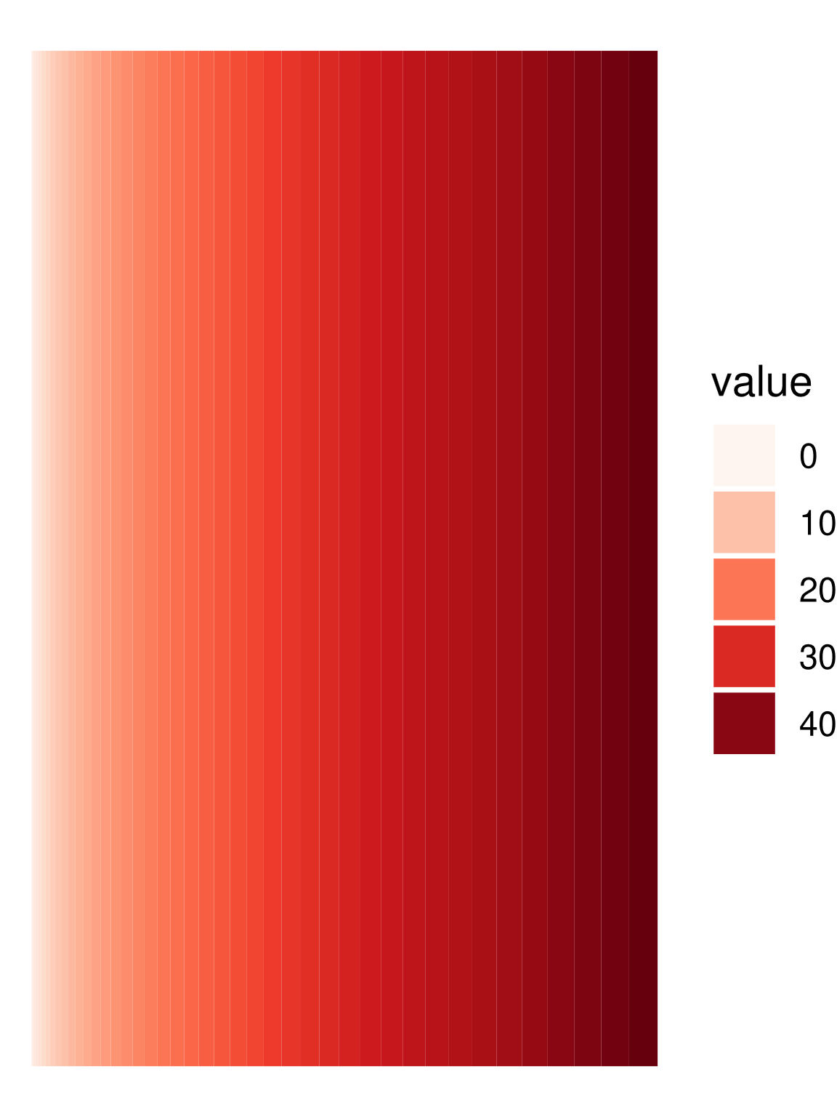
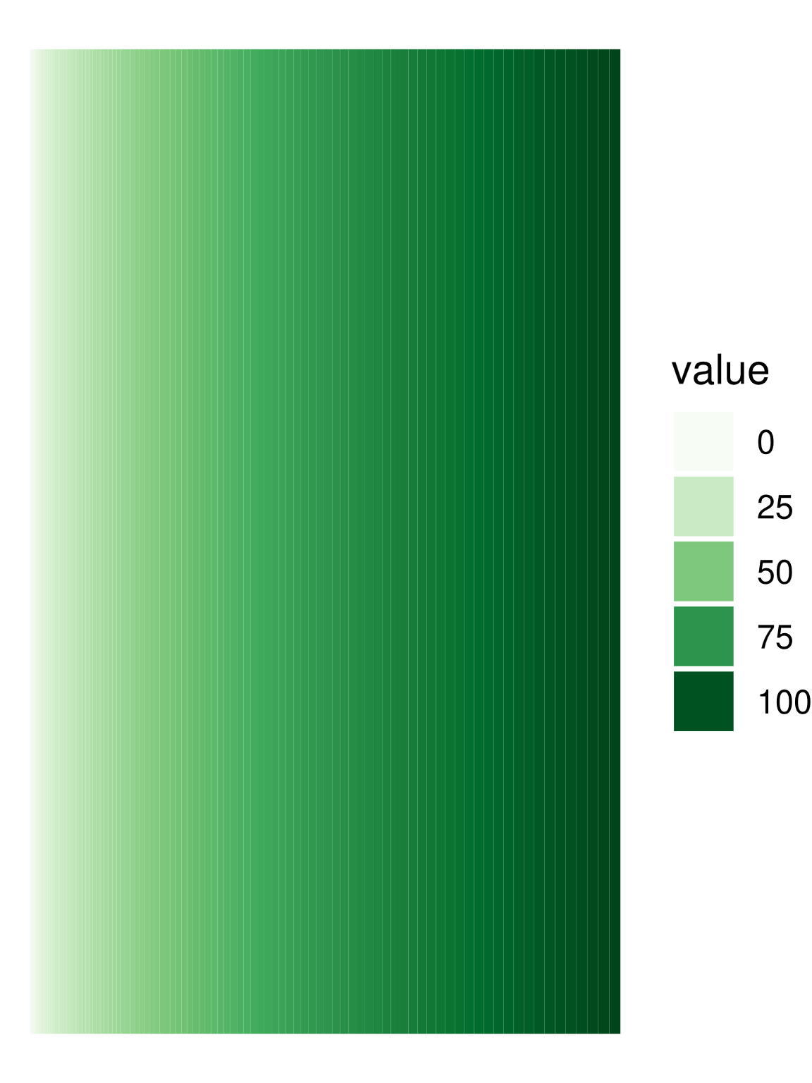
Known NUMTs vs RIL
…..250

Slide 12
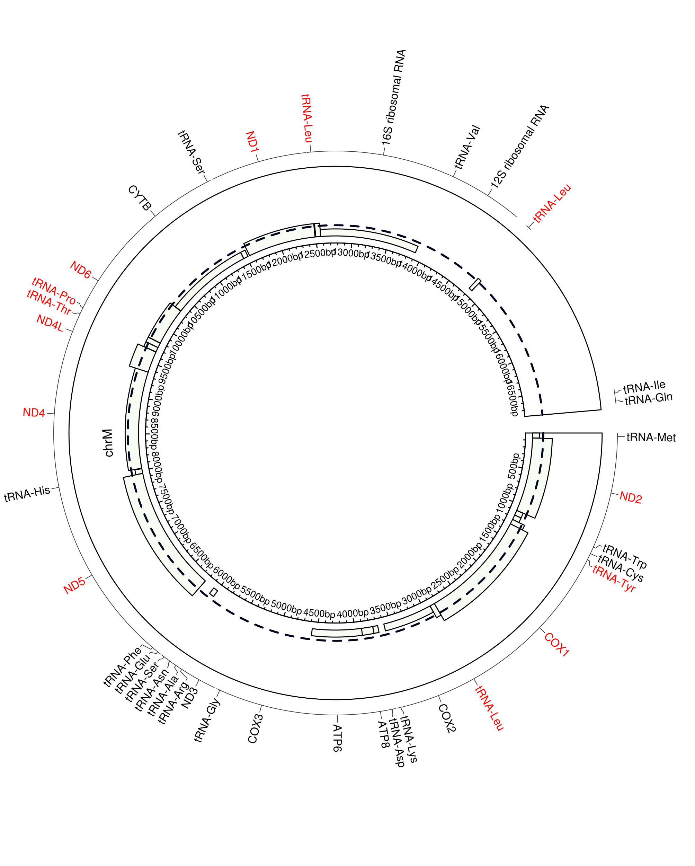
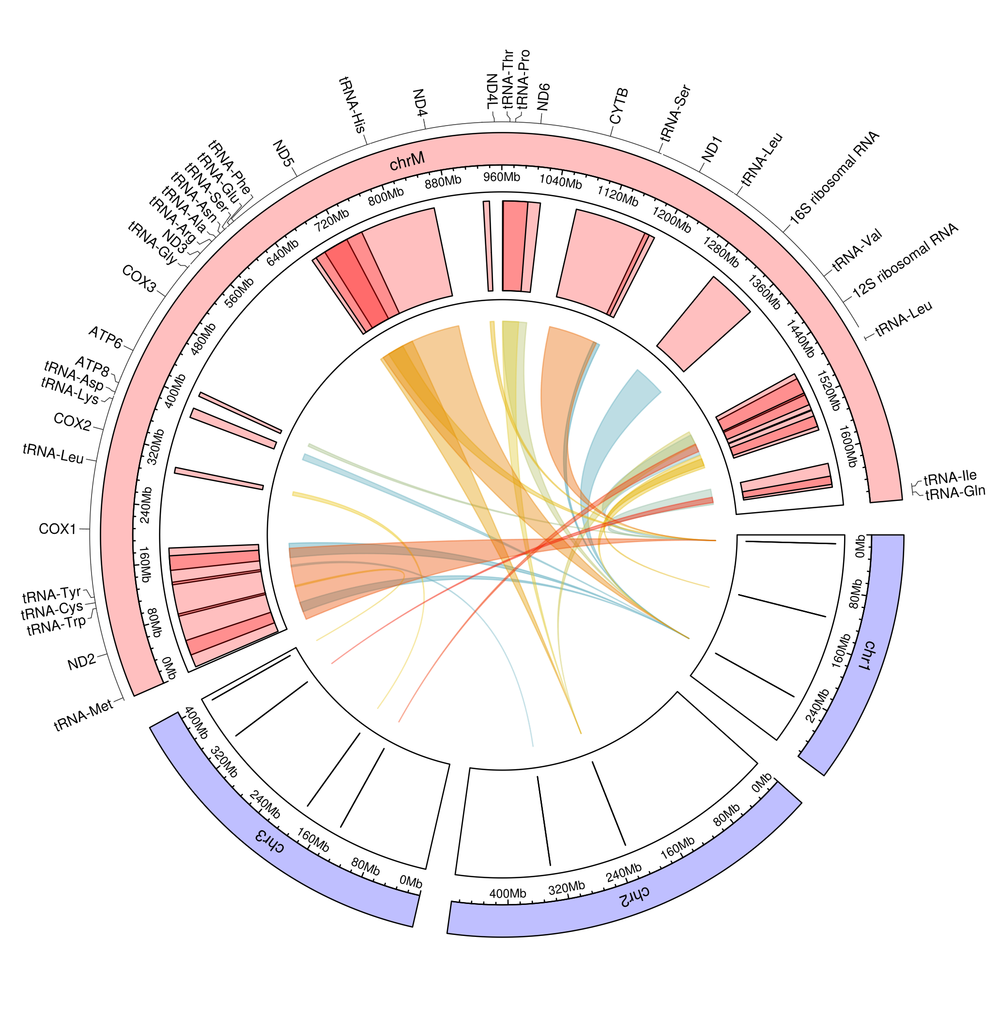
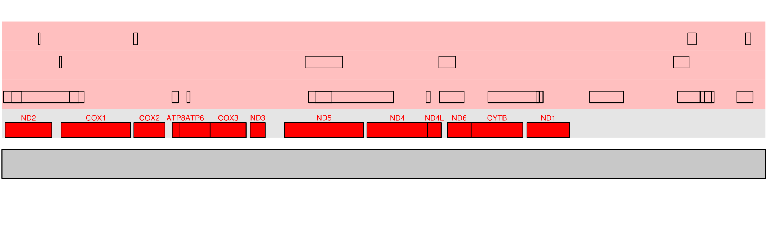
WGS 017 E20 F03
Chr:3
Chr:2
Chr:1

Slide 13
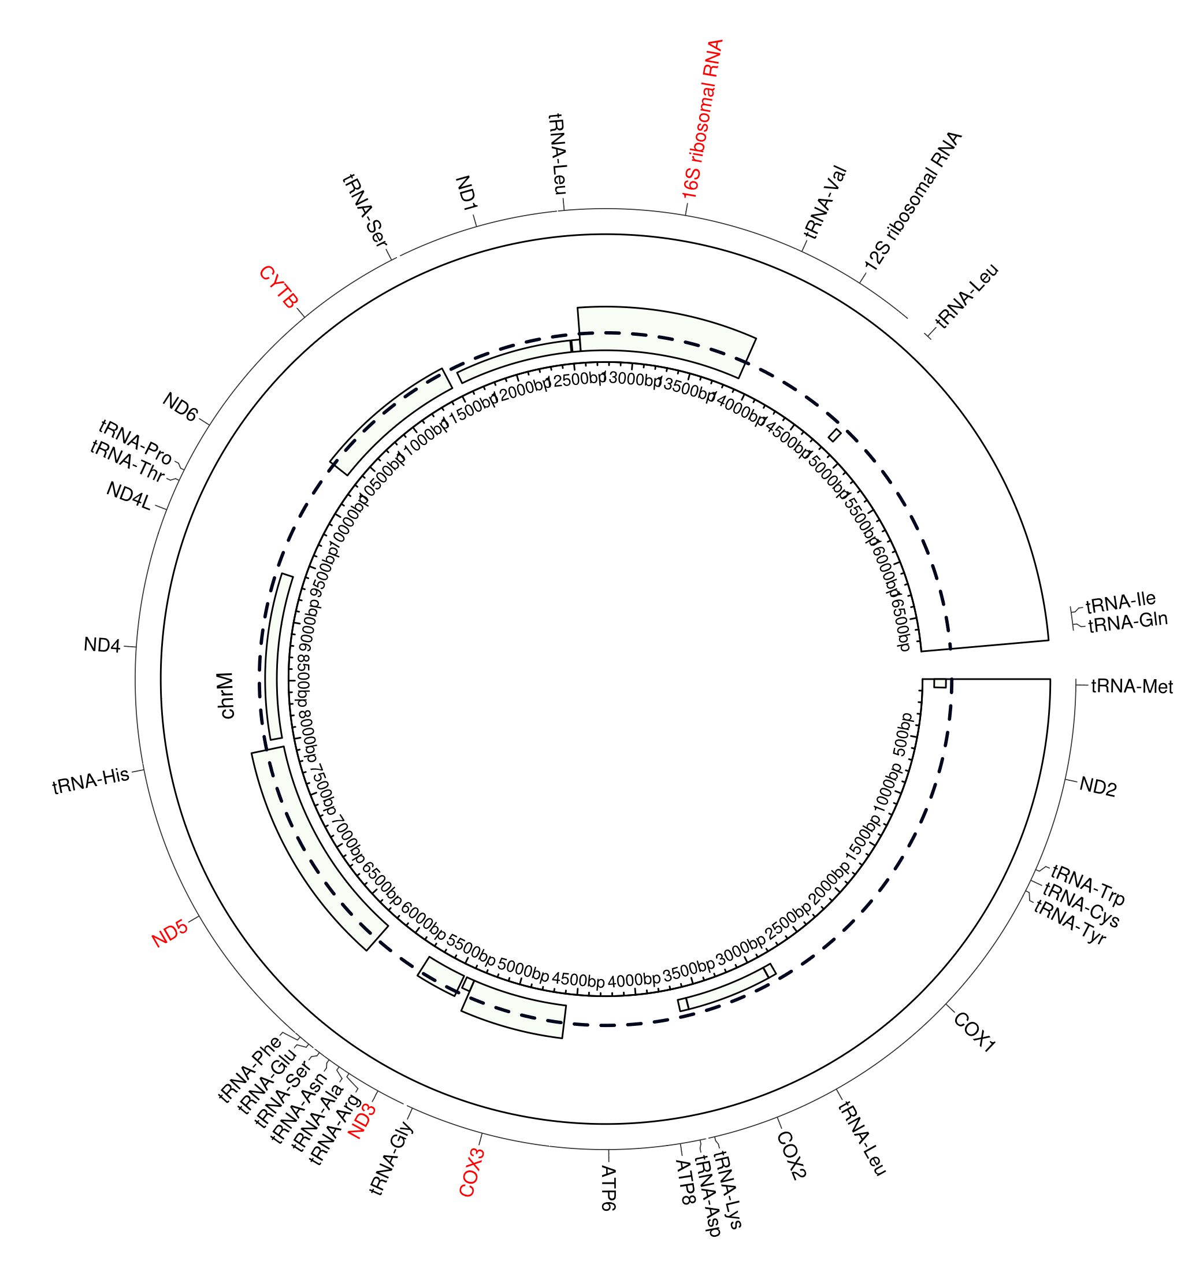
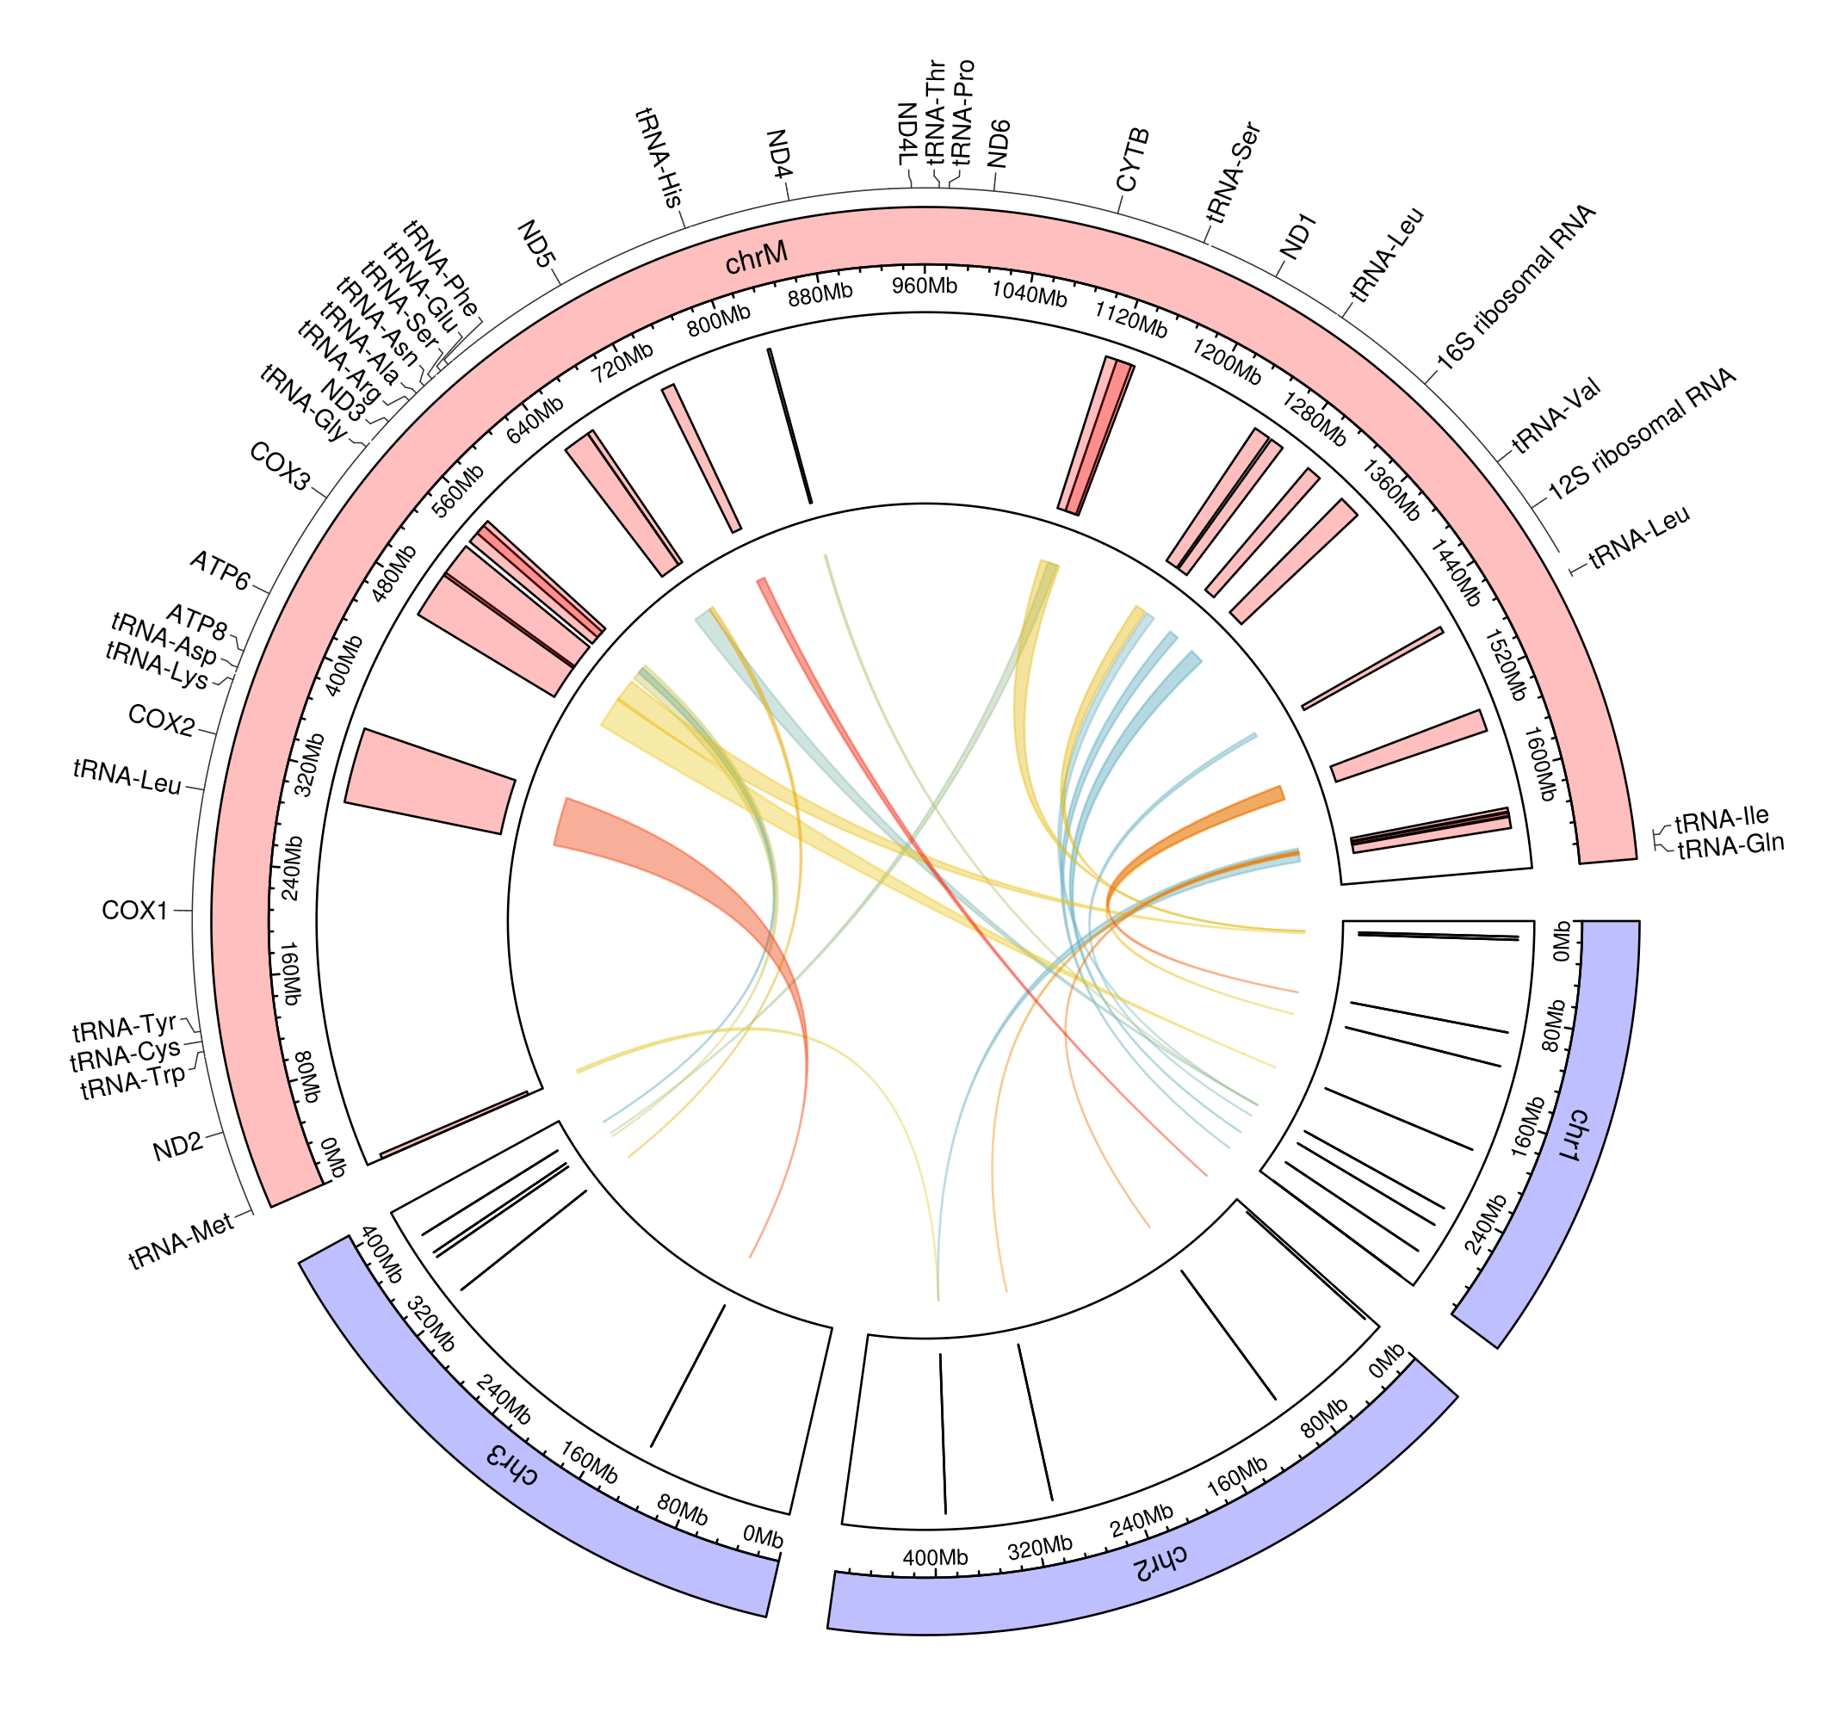
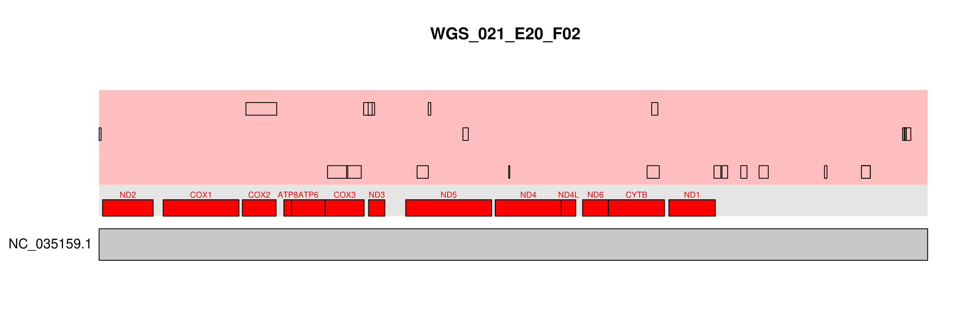
WGS 021 E20 F02
Chr:3
Chr:2
Chr:1

Slide 14
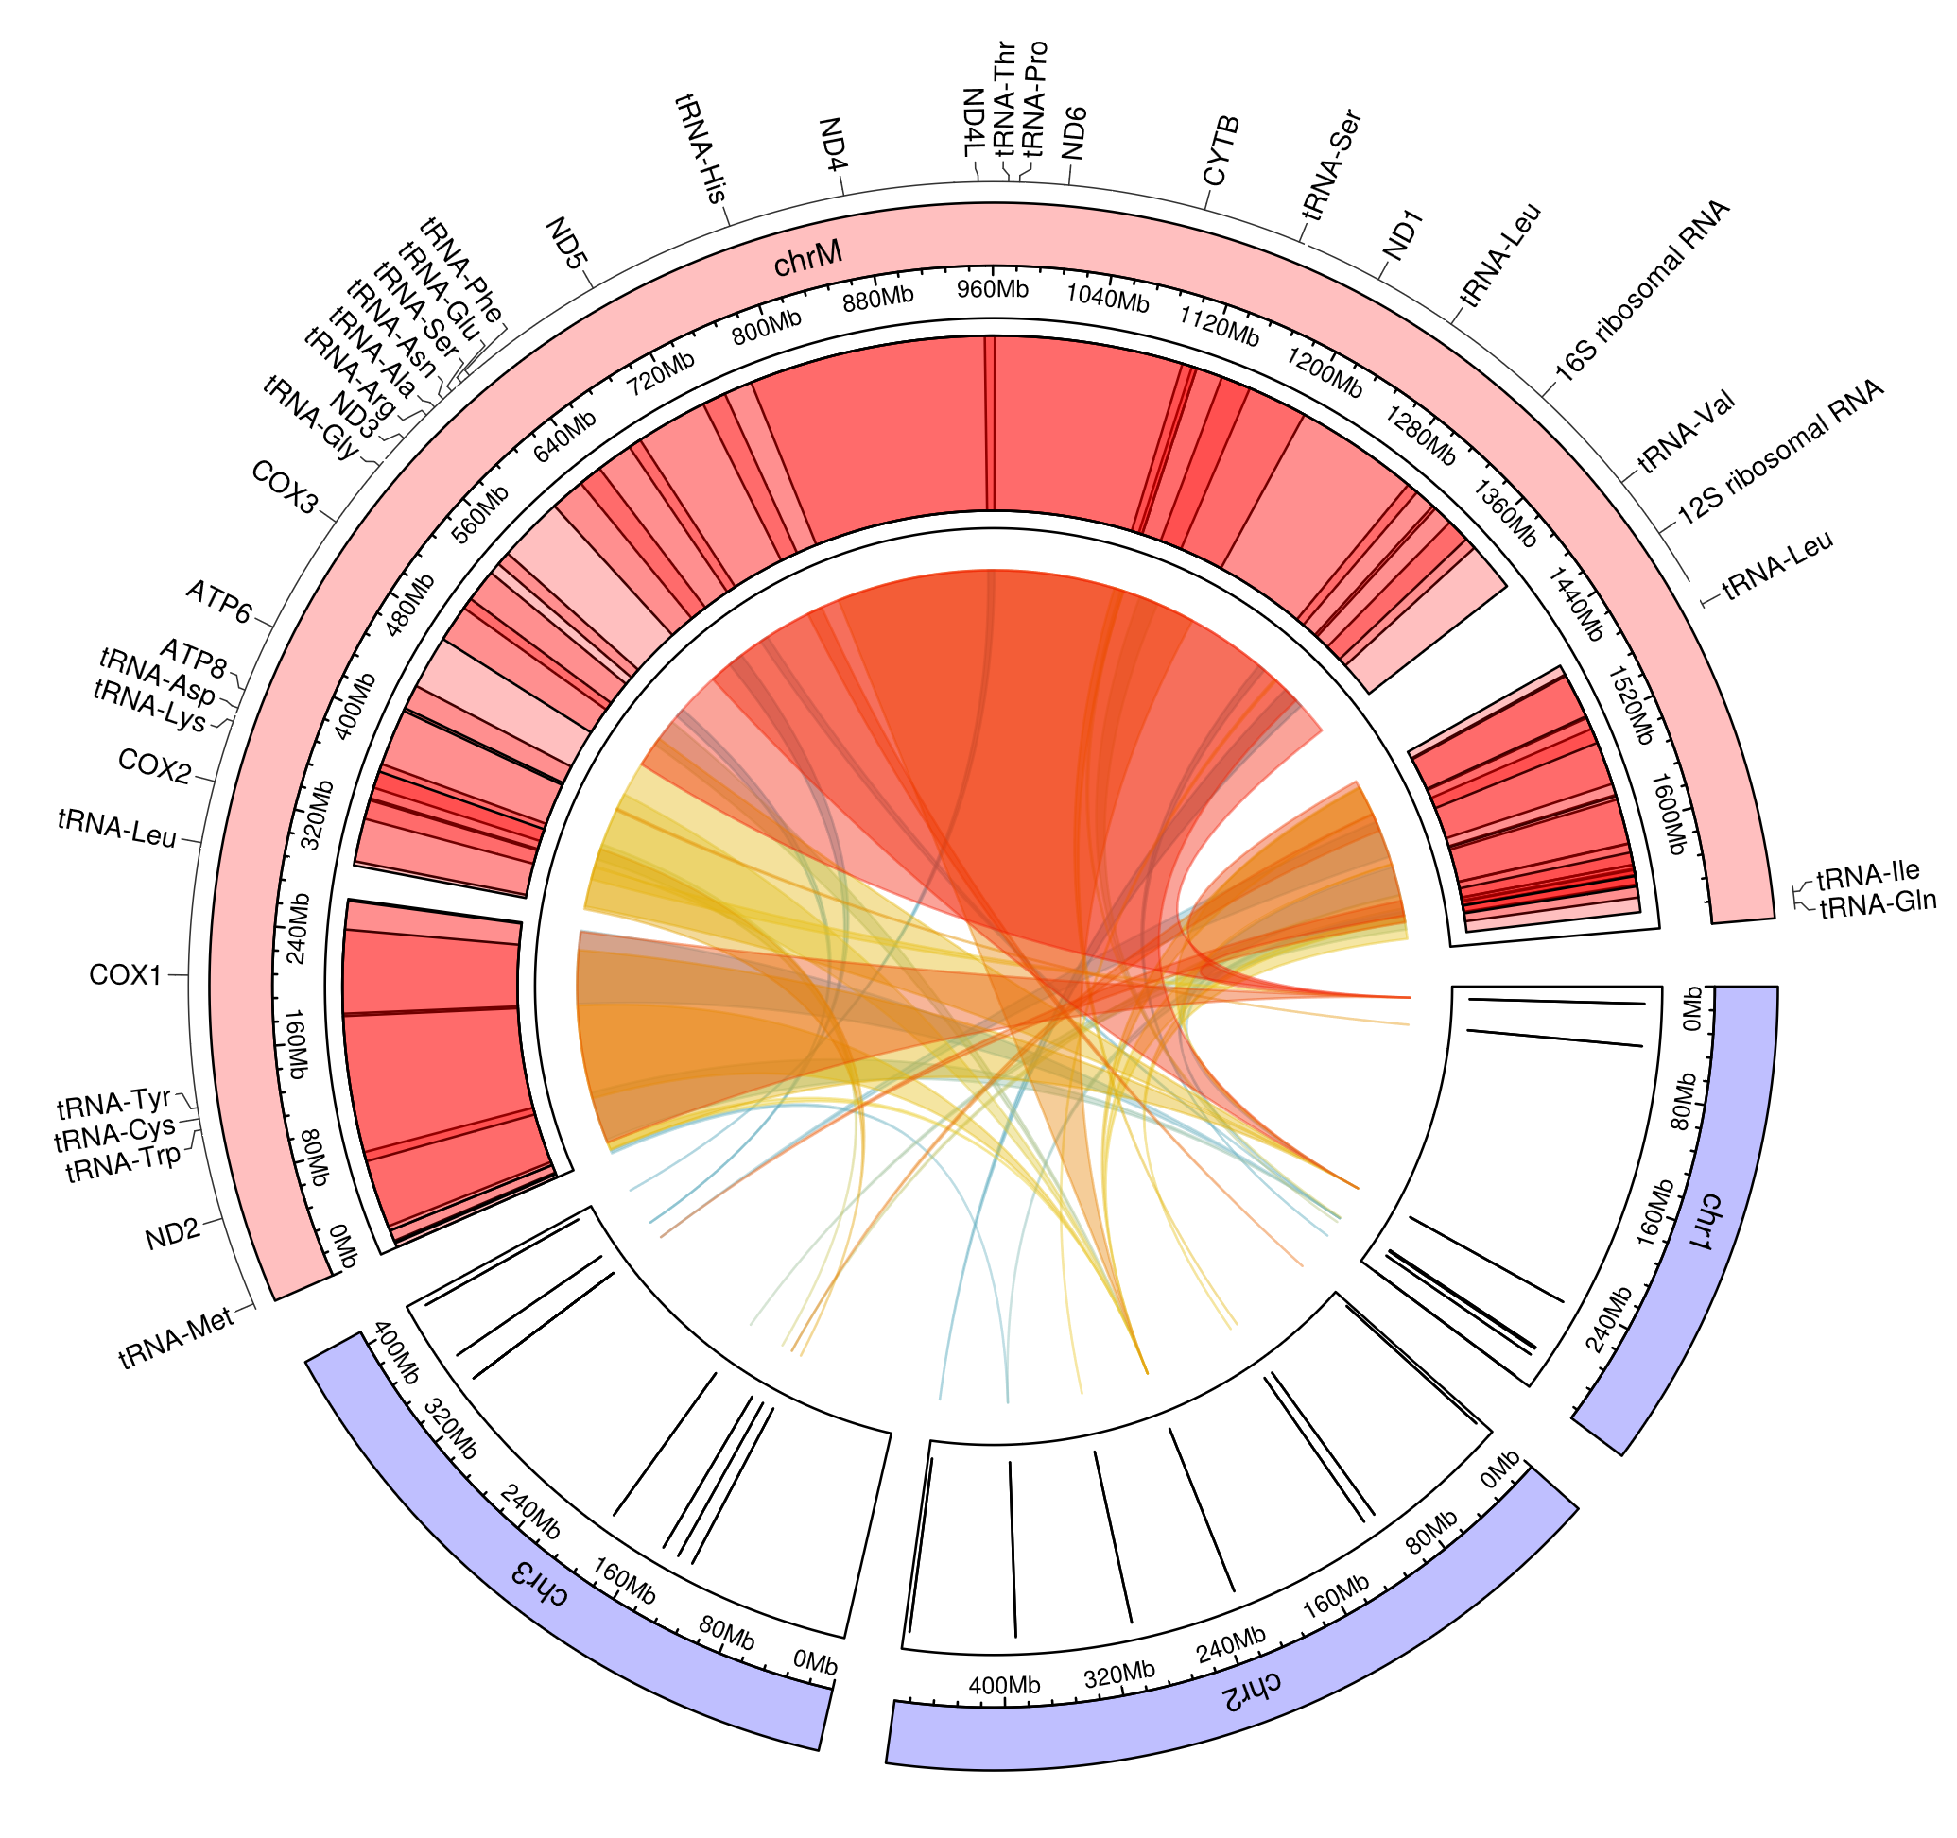
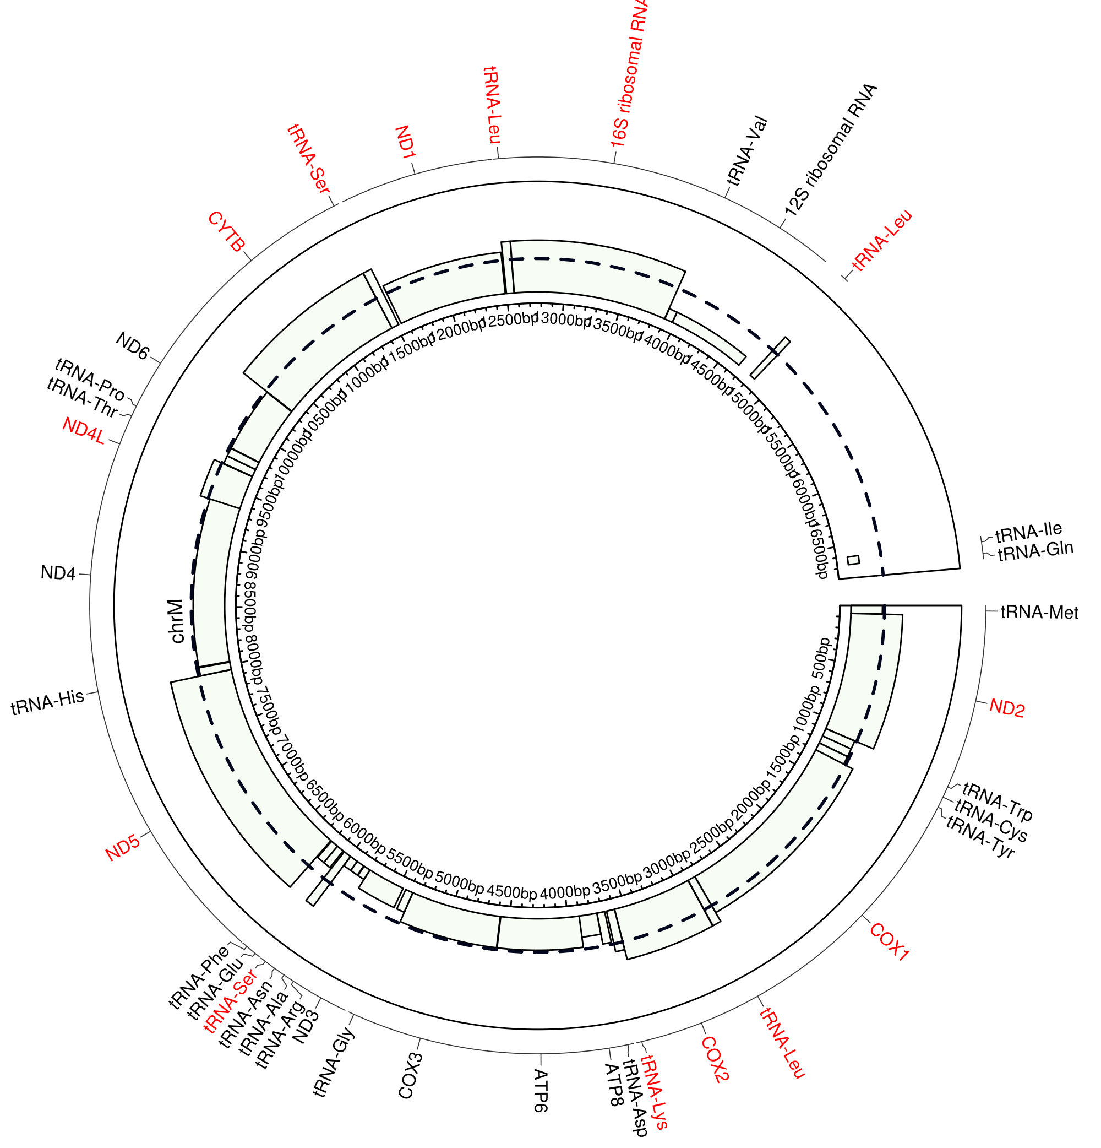
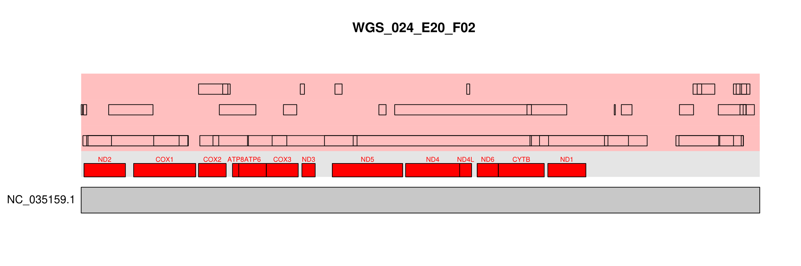
WGS 024 E20 F02
Chr:3
Chr:2
Chr:1

Slide 15
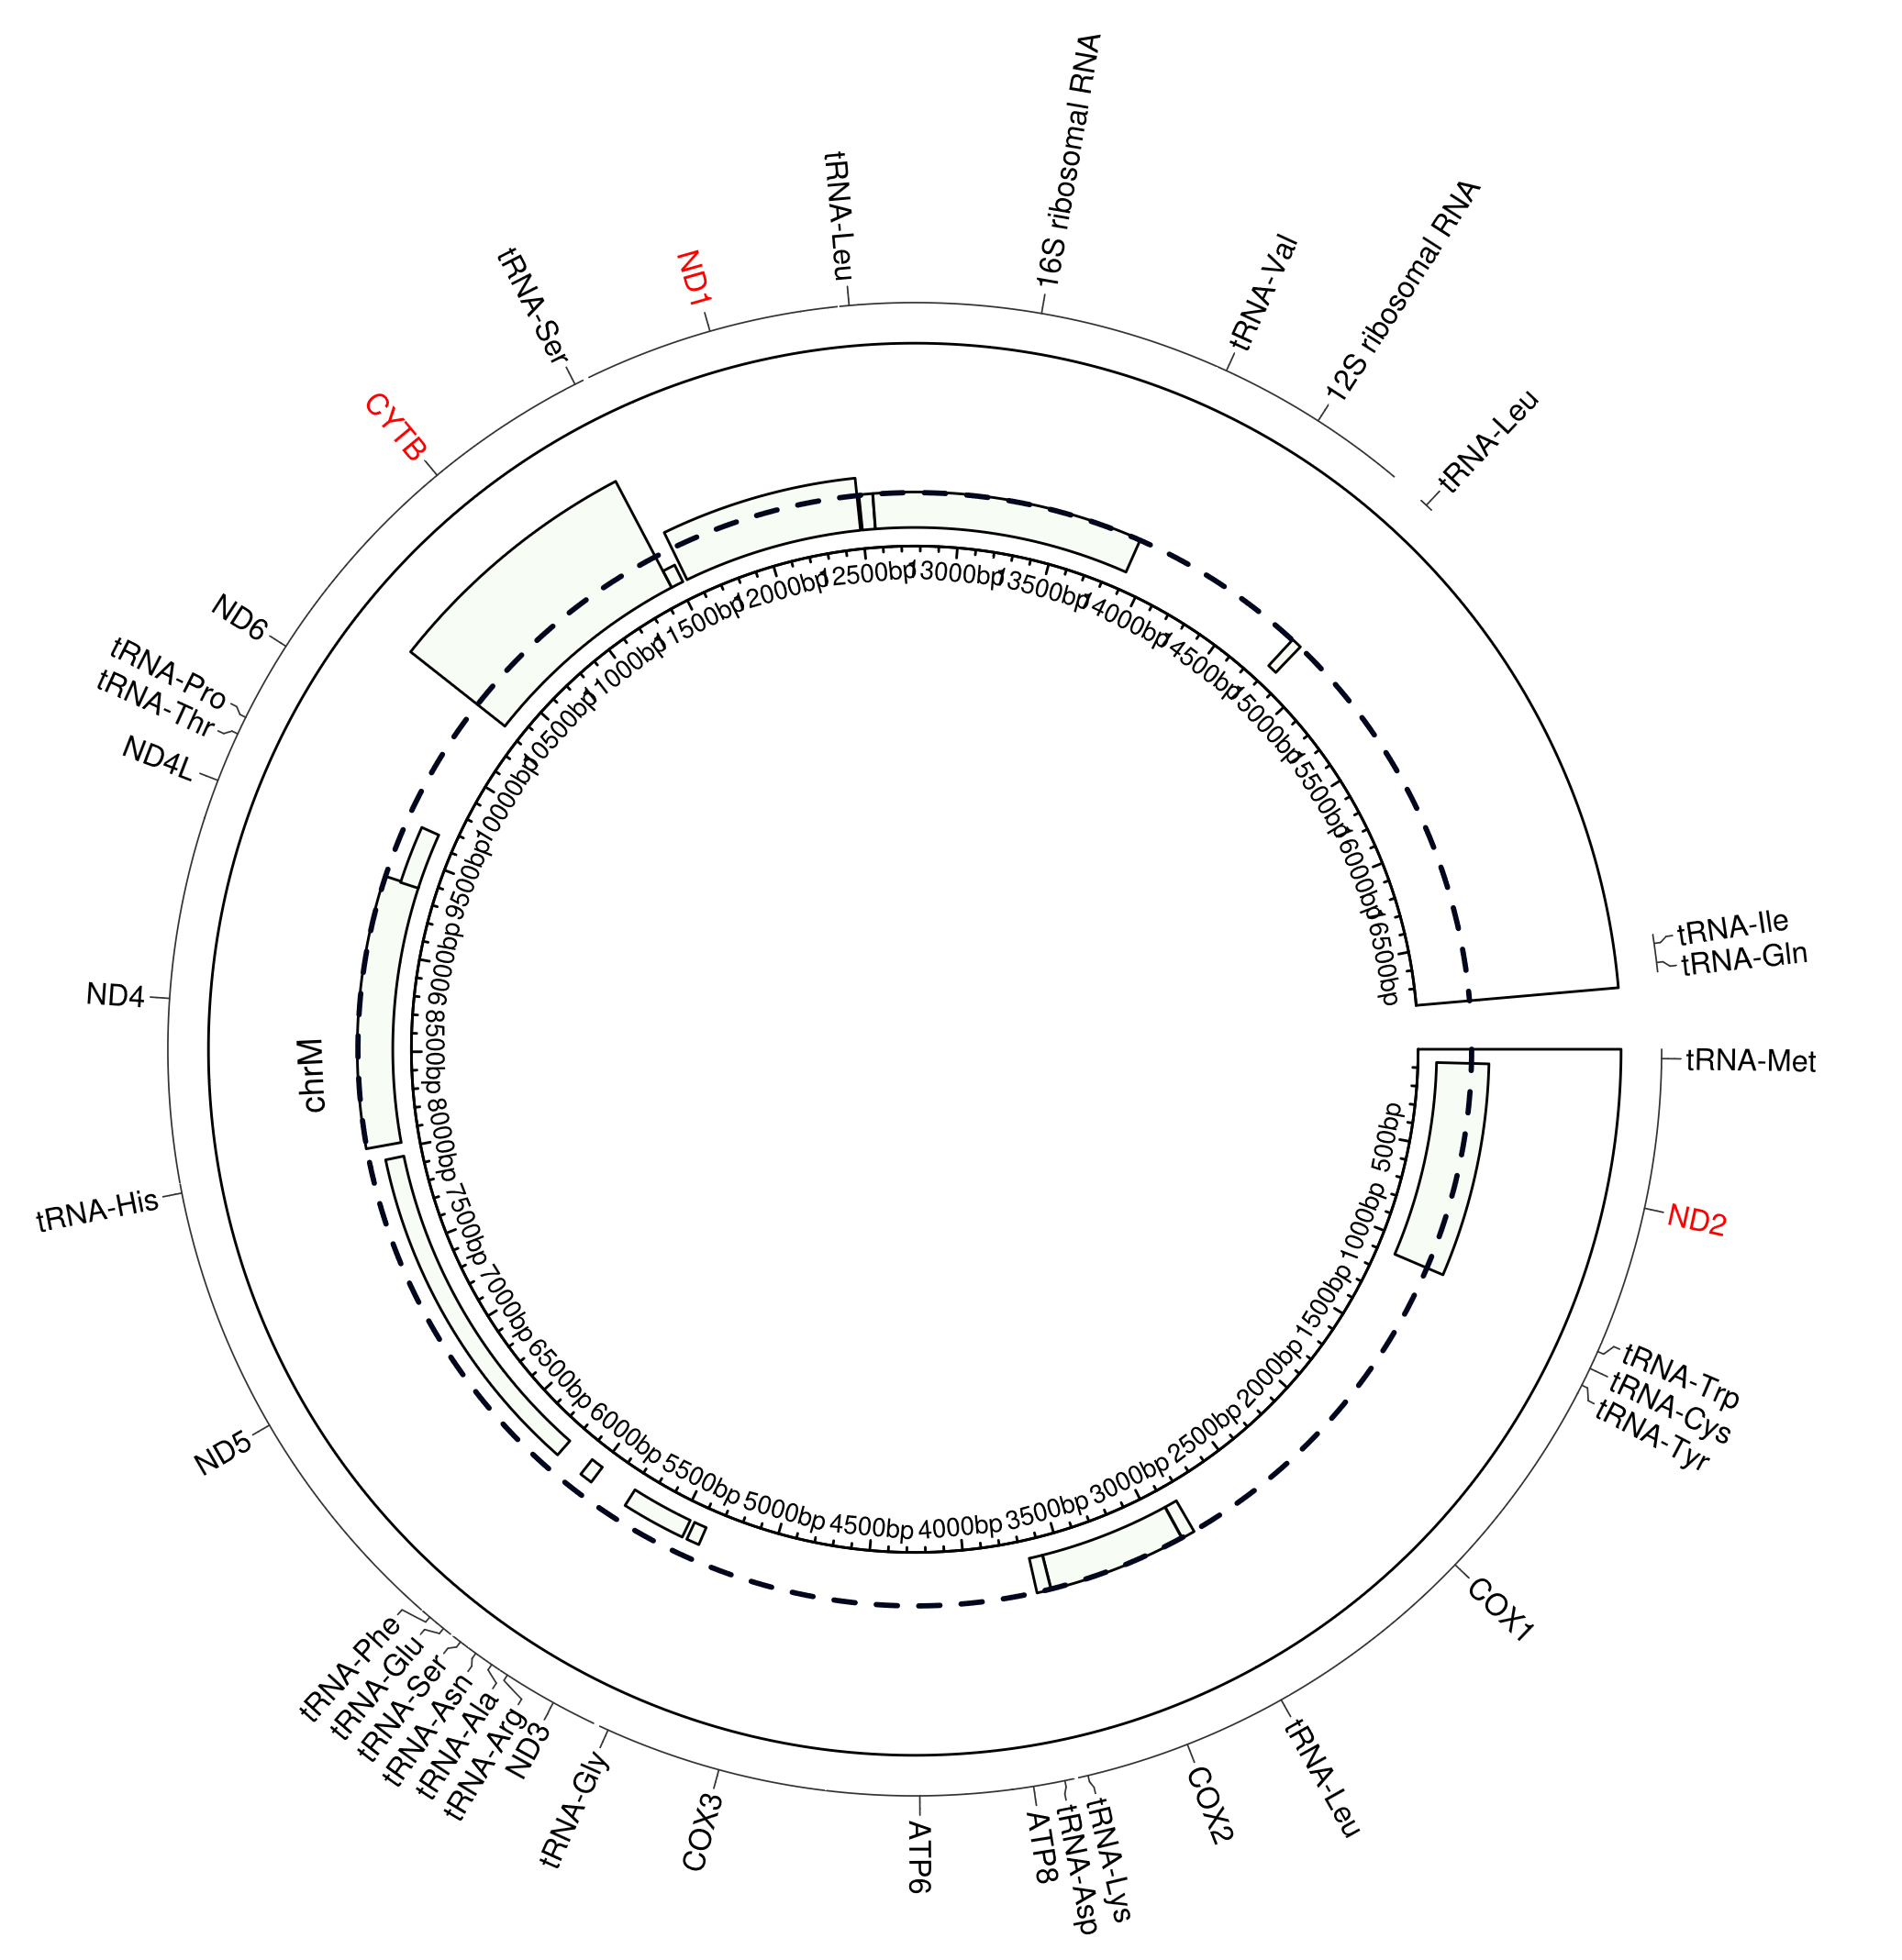
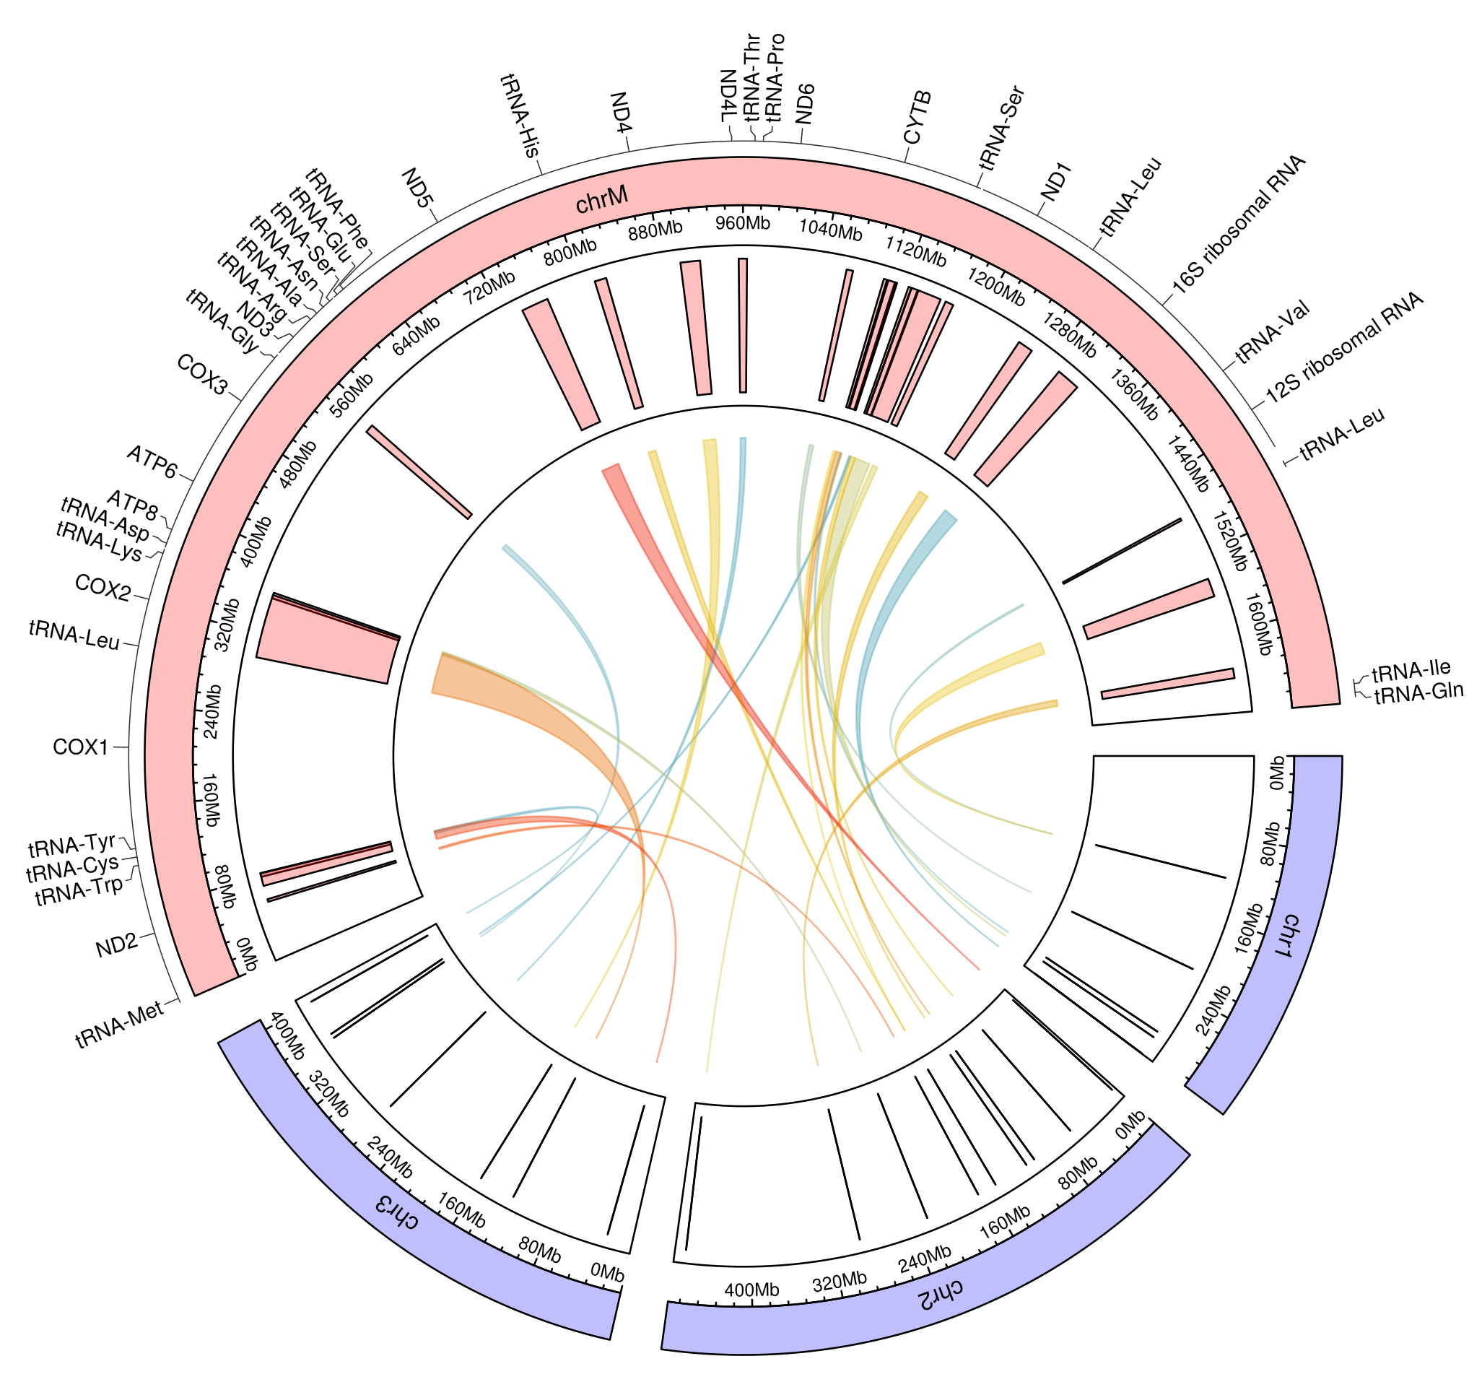
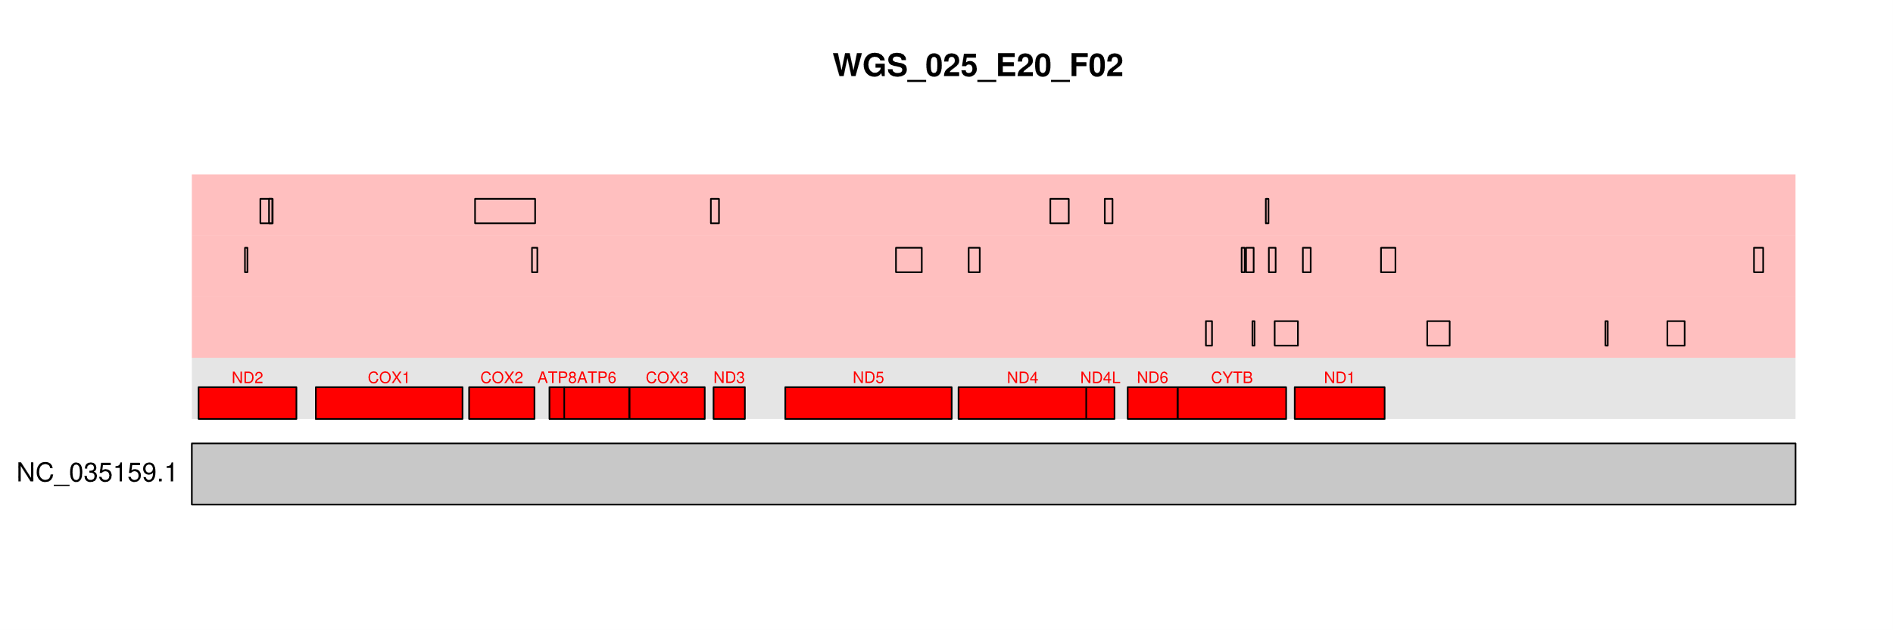
WGS 025 E20 F02
Chr:3
Chr:2
Chr:1

Slide 16
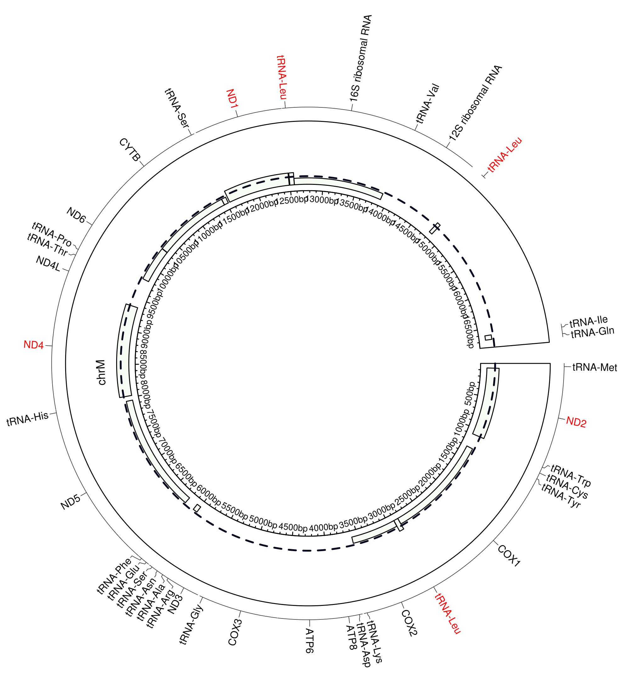
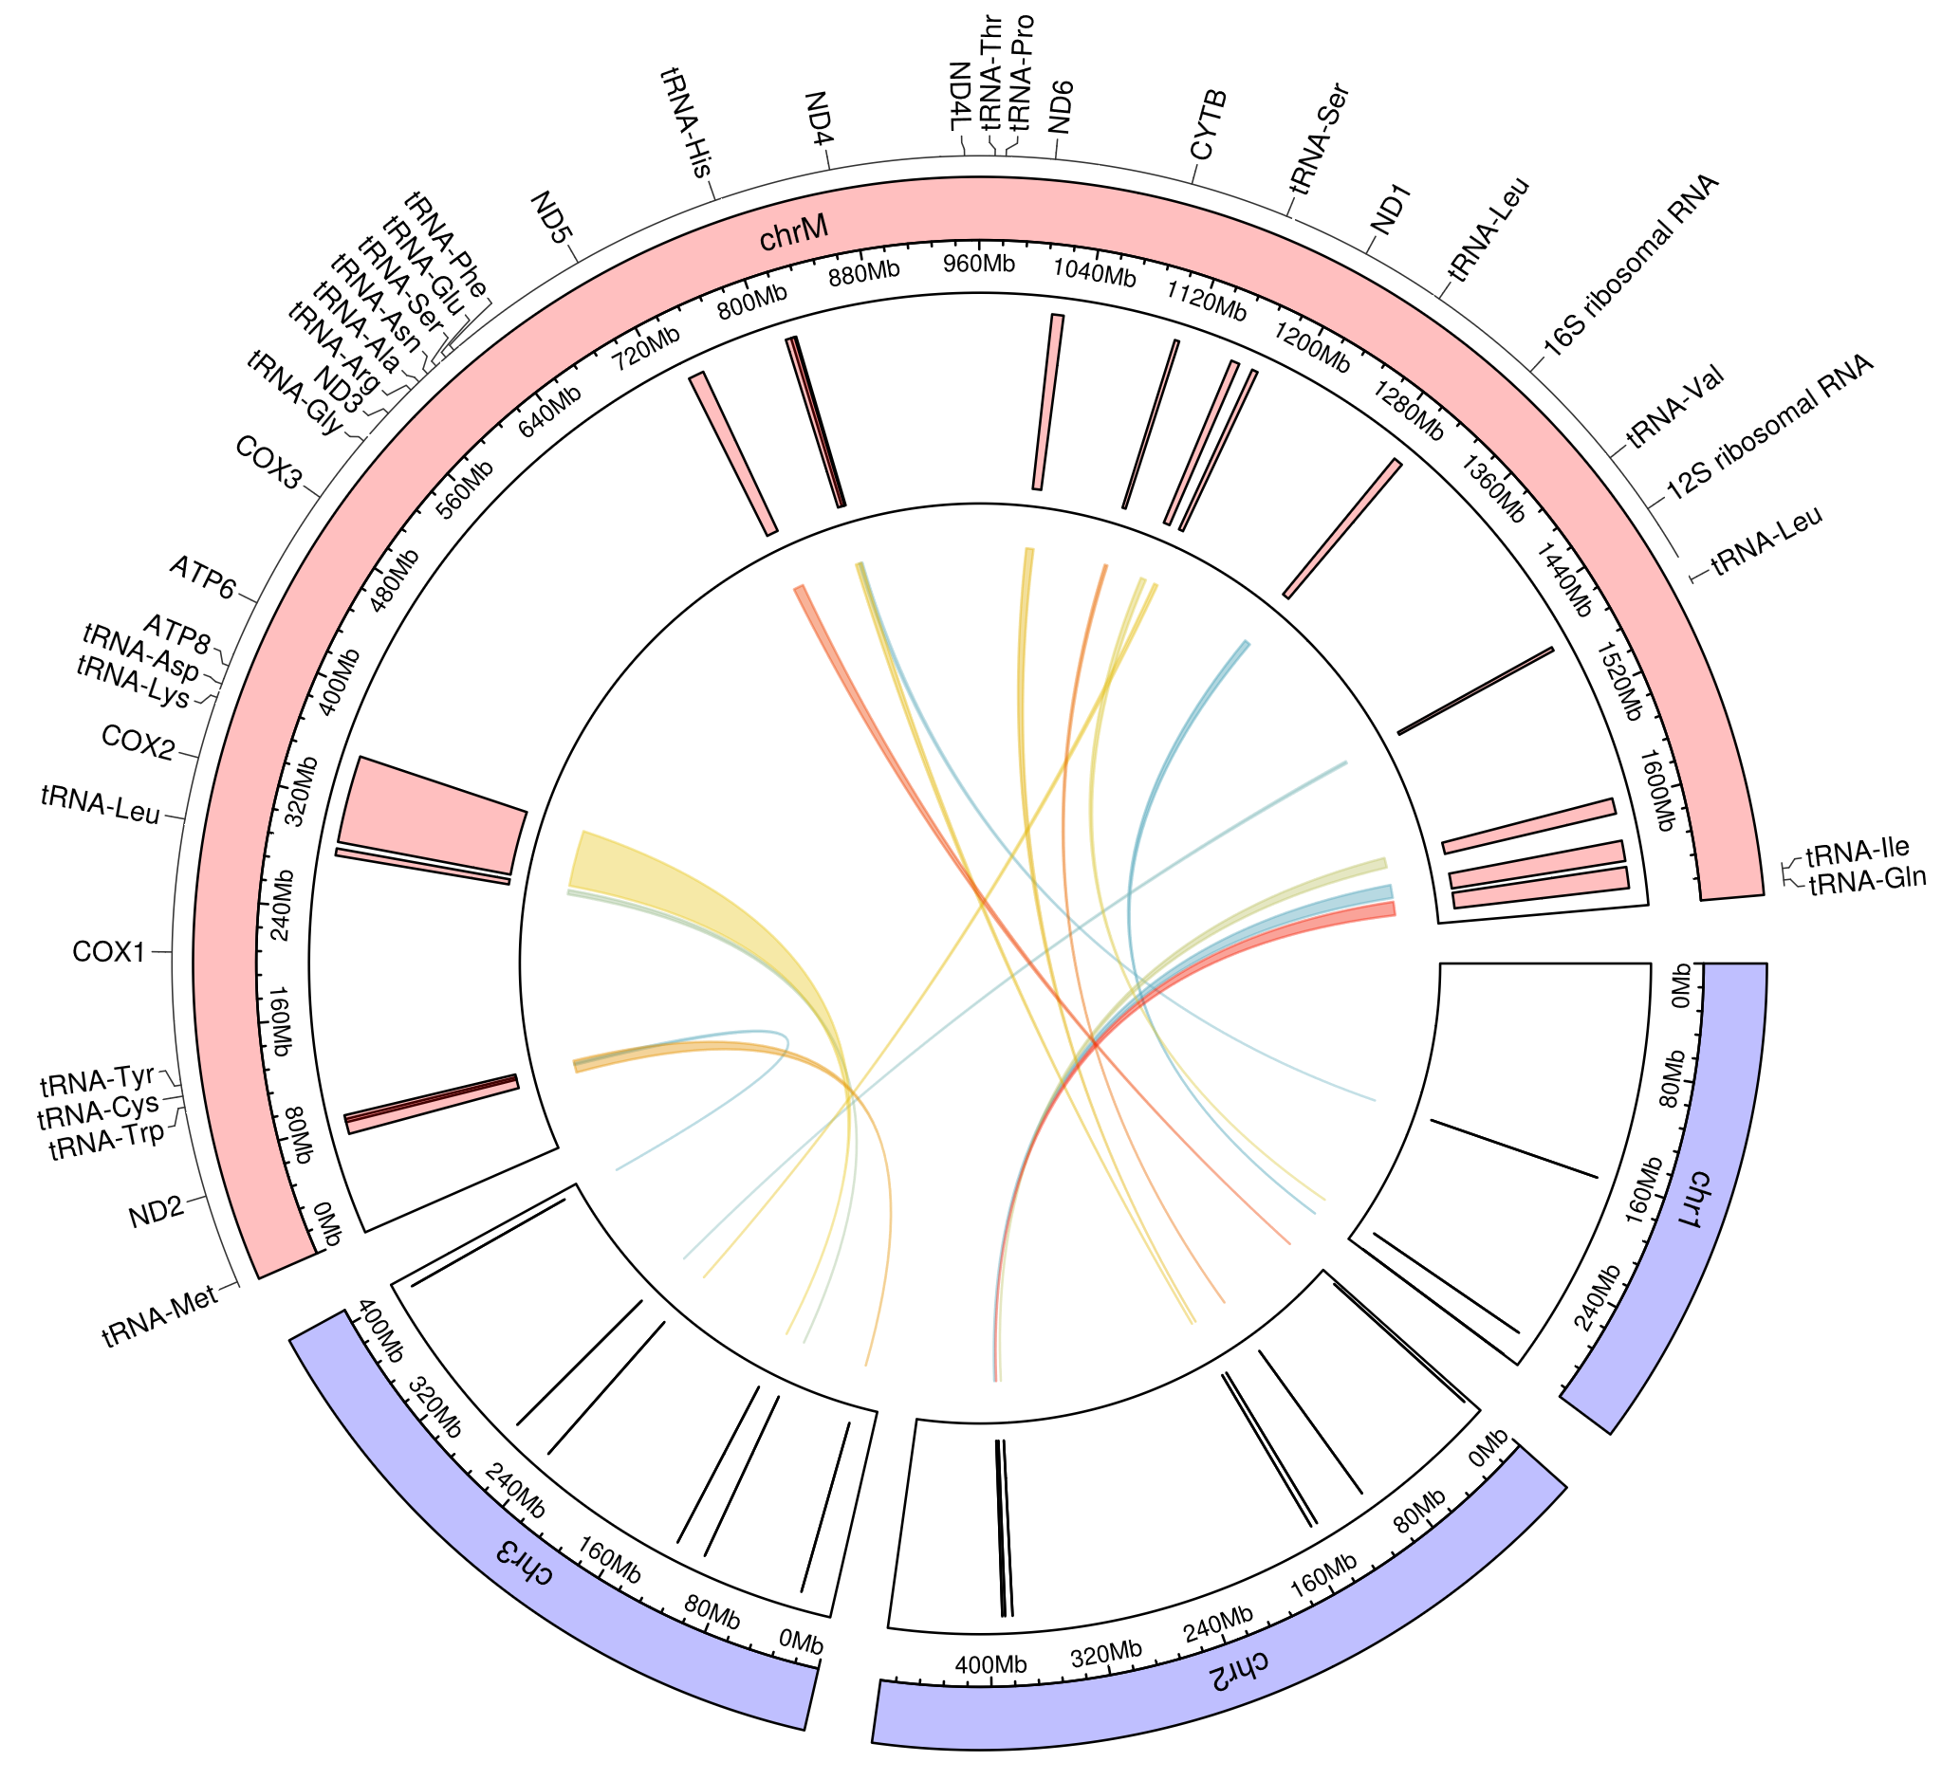
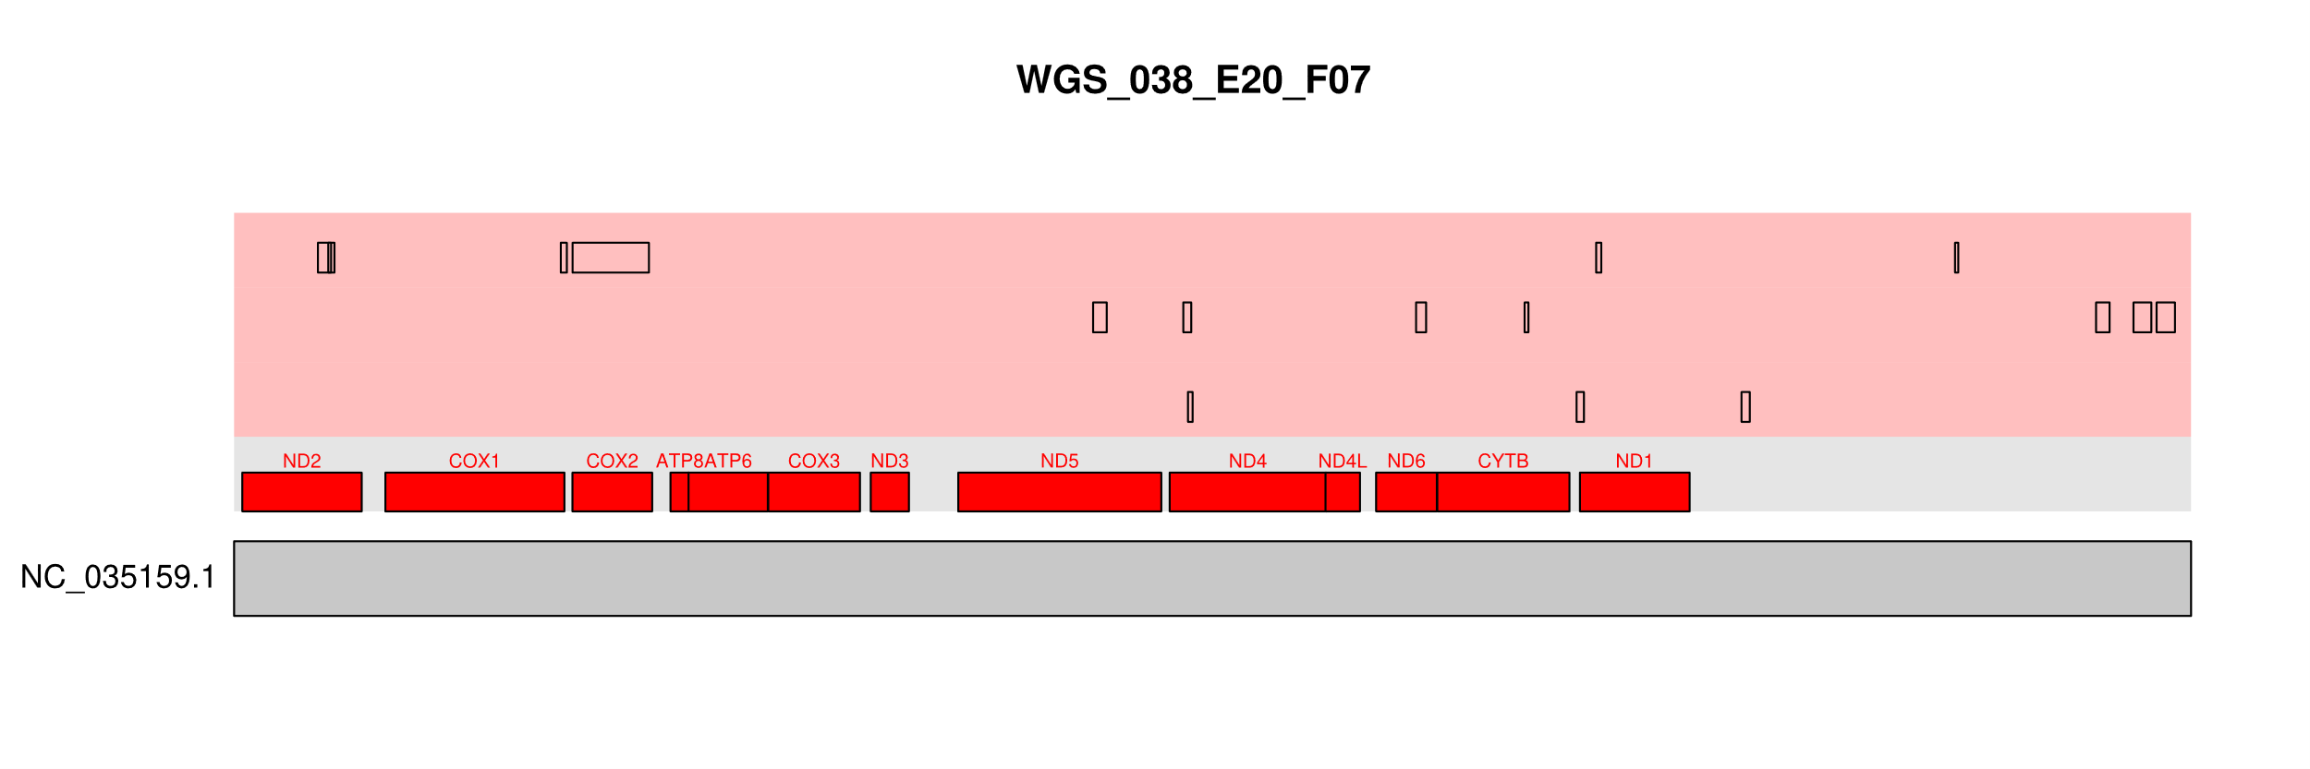
WGS 038 E20 F07
Chr:3
Chr:2
Chr:1

Slide 17
